Slide 1
Group D Vehicle simulator project
Ludvig Modig
Rickard Ljung
Marcin Zwierzynski

Slide 2




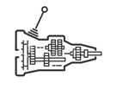
Project assumptions:

Slide 3
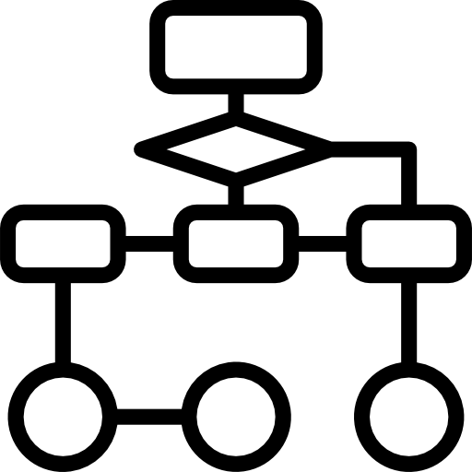
Minimum viable product

Slide 4





Working process

Slide 5
Software Architecture

